Slide 1
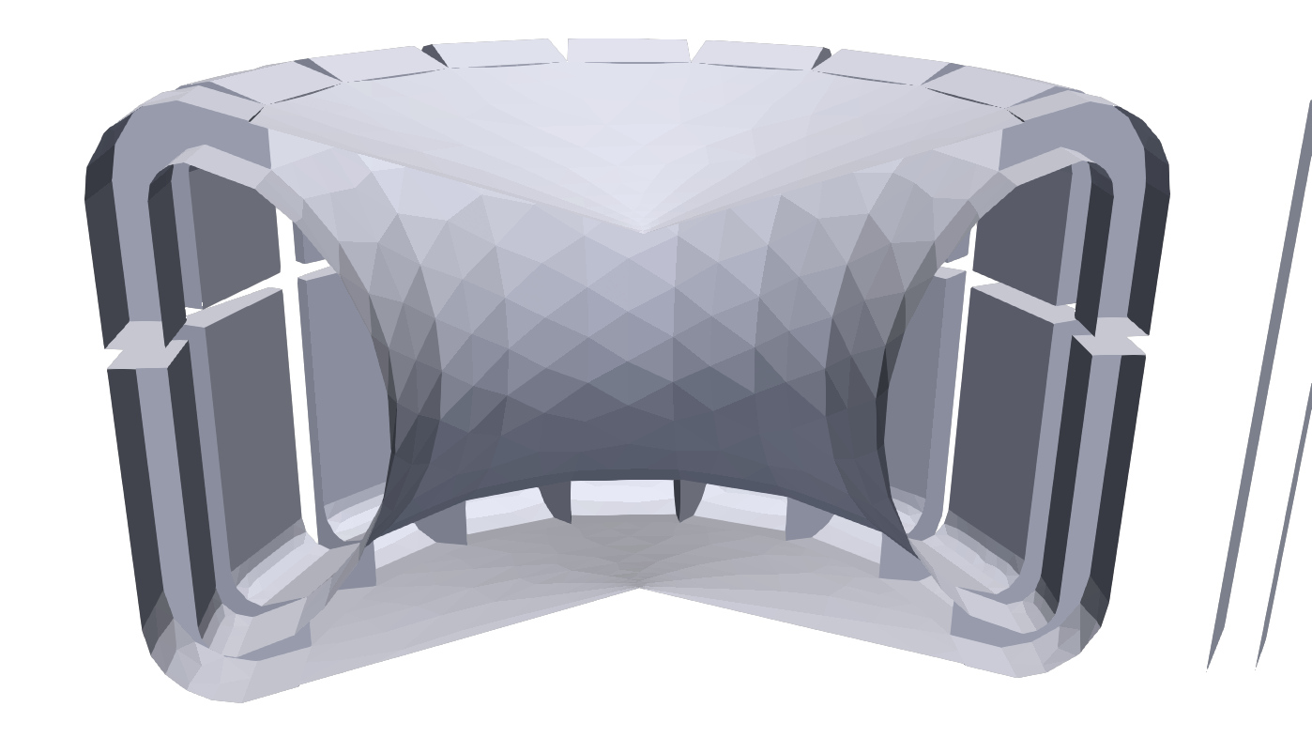
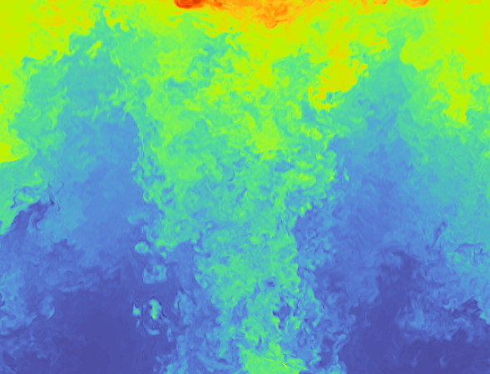
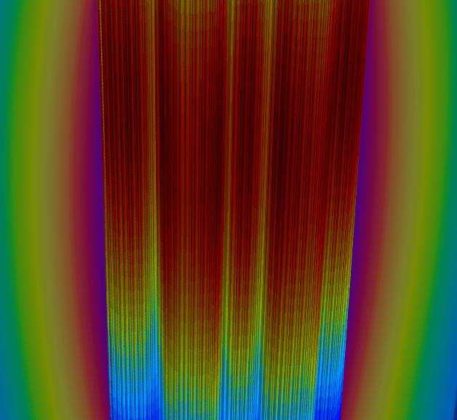
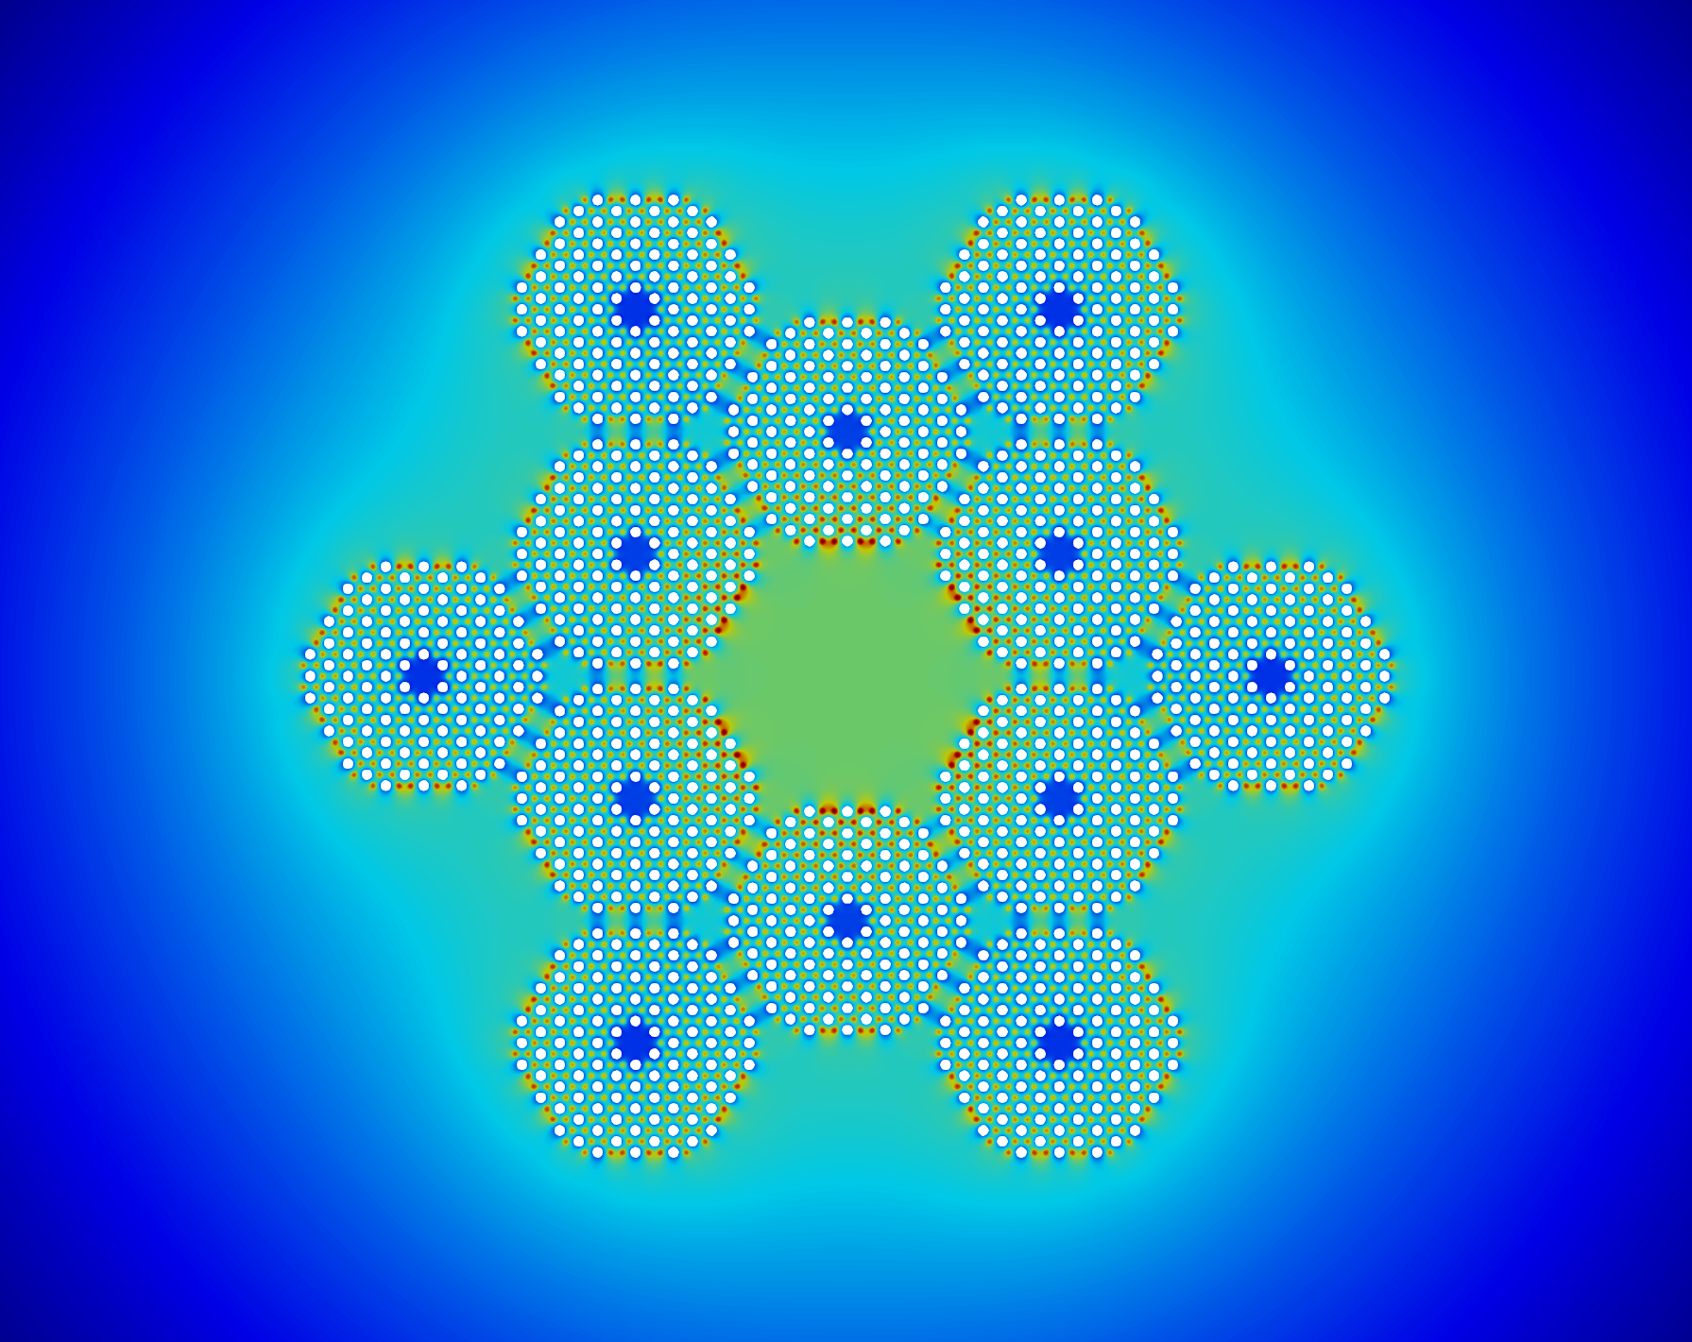
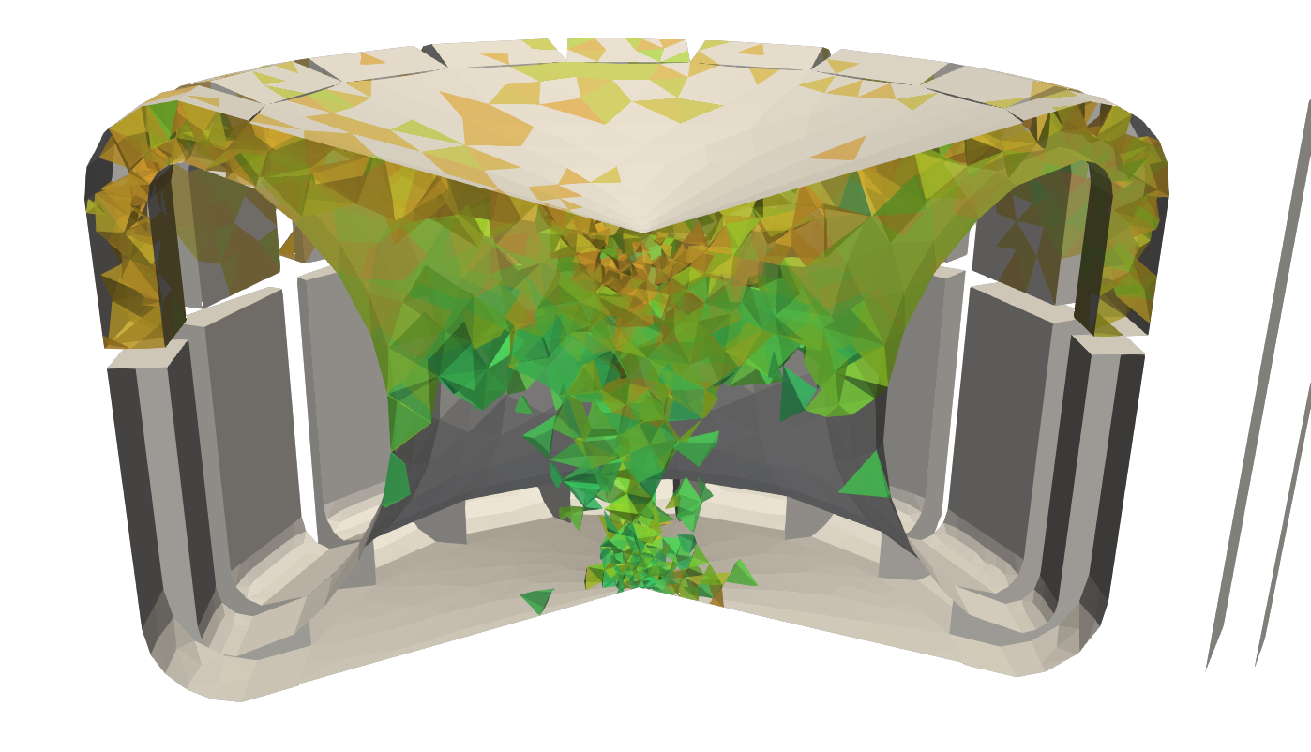
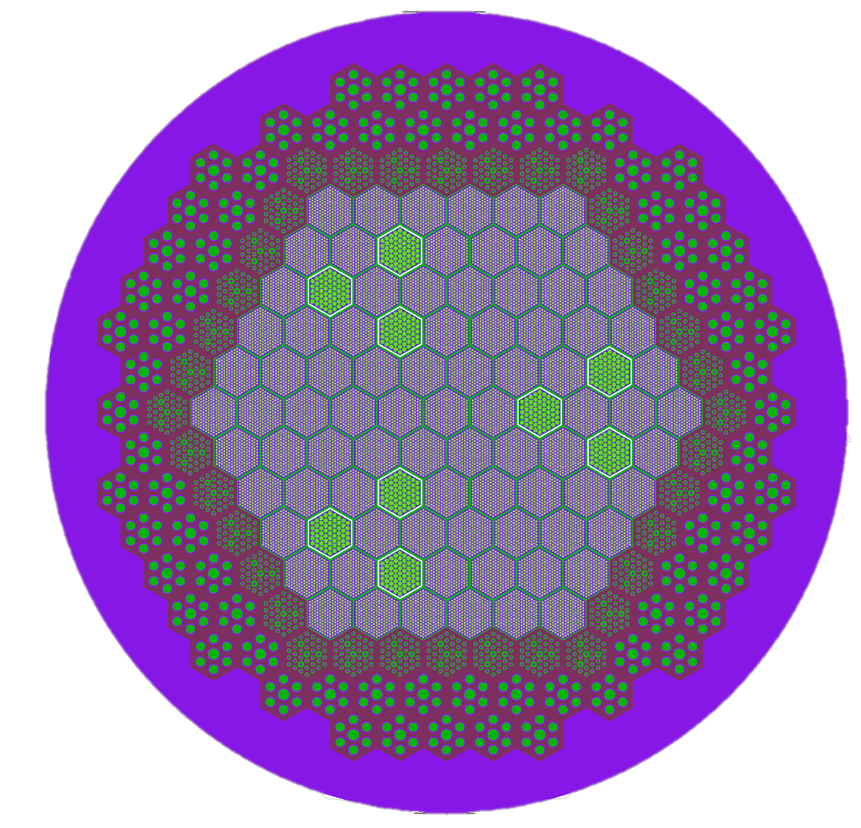
Cardinal: Integrating OpenMC with the
MOOSE Ecosystem
April Novak
Assistant Professor
Nuclear, Plasma, and Radiological Engineering (NPRE)
University of Illinois, Urbana-Champaign
Joint Appointment, Nuclear Science and Engineering (NSE) Division
Argonne National Laboratory

Slide 2
(Re)-Introduction to Cardinal and OpenMC (15 min)
Tokamak, OpenMC + heat conduction coupling (75 min)
Notes:
complementary to experimental programs

Slide 3
Objectives:
Introduce how to couple OpenMC to MOOSE
Learn how to apply multiphysics feedback to CAD Monte Carlo models
Explore data postprocessing in Cardinal
Assumptions:
Attended the OpenMC and MOOSE workshop sessions
Basic familiarity with Unix-based environment
Basic familiarity with radiation transport and heat conduction
Notes:
complementary to experimental programs

Slide 4
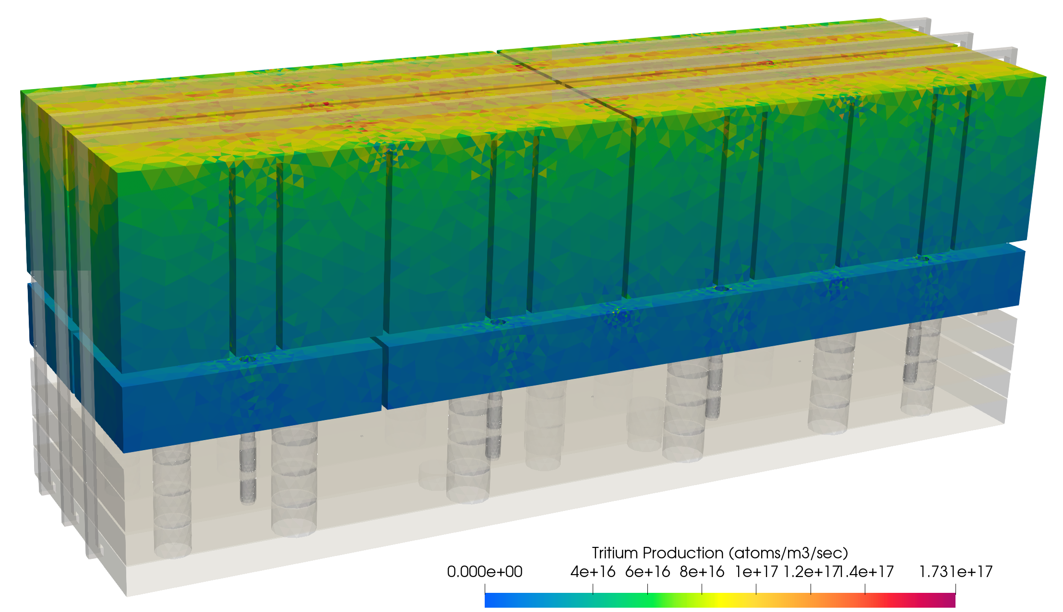
Cardinal
Couples the OpenMC Monte Carlo neutron and photon transport code to MOOSE
Open source, extensible for research purposes
Adopt best practices for software development
High performance, scalable on HPC
Can be used to predict:
Tritium breeding
Nuclear heating (power deposition)
Shielding requirements
Material activation, radioactive waste classification
Material damage (DPA), gas production
Non-proliferation analyses
Diagnostics, sensor responses
Tritium production in a breeder module
and how these are influenced by OTHER PHYSICS
Notes:
complementary to experimental programs

Slide 5
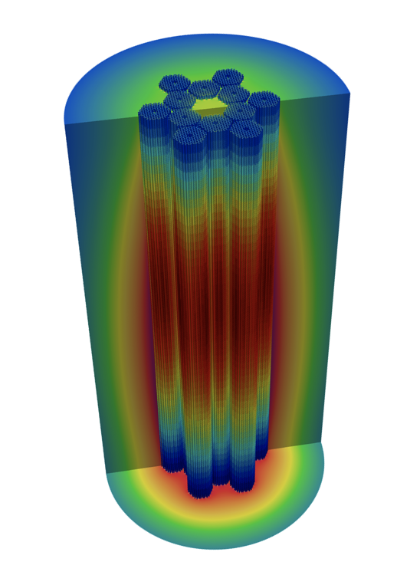
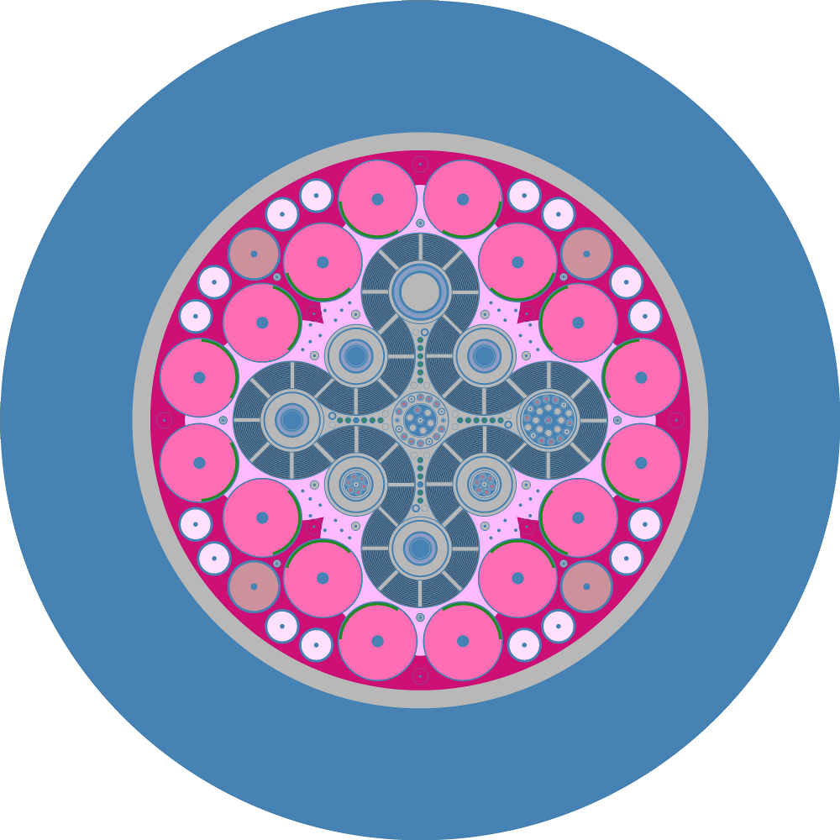
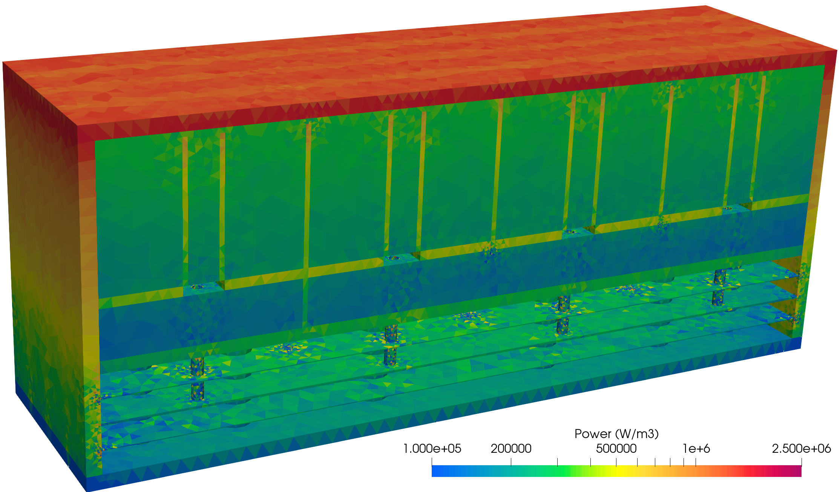
OpenMC
Modes/solvers: Fixed-source, k-eigenvalue, depletion, volume, geometry plotting
Fixed source neutron-photon transport
k-eigenvalue neutron transport
built-in geometry plotter
Breeder blanket module
Fission reactor
Fission test reactor
Notes:
complementary to experimental programs

Slide 6
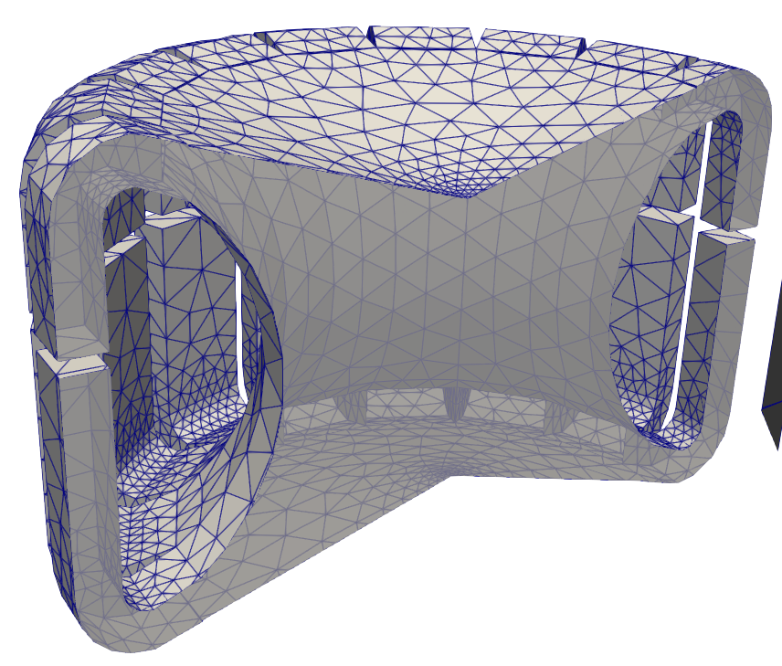
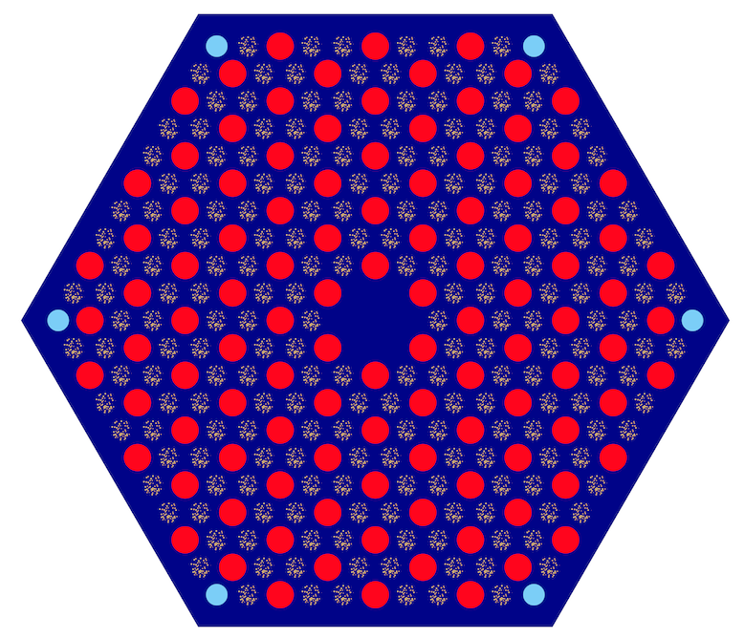
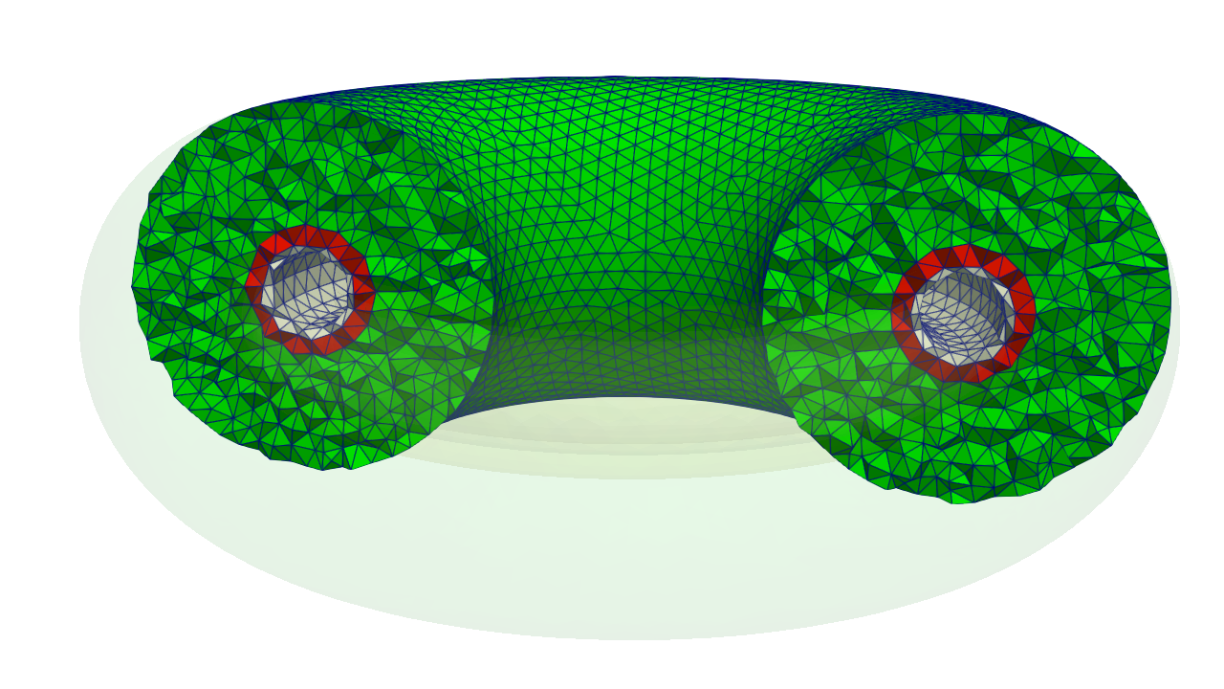
OpenMC
Modes/solvers: Fixed-source, k-eigenvalue, depletion, volume, geometry plotting
Geometry: Constructive solid geometry, CAD surface mesh, unstructured mesh
Constructive Solid Geometry (CSG)
DAGMC CAD surface meshes
libMesh unstructured volume mesh
Notes:
complementary to experimental programs

Slide 7
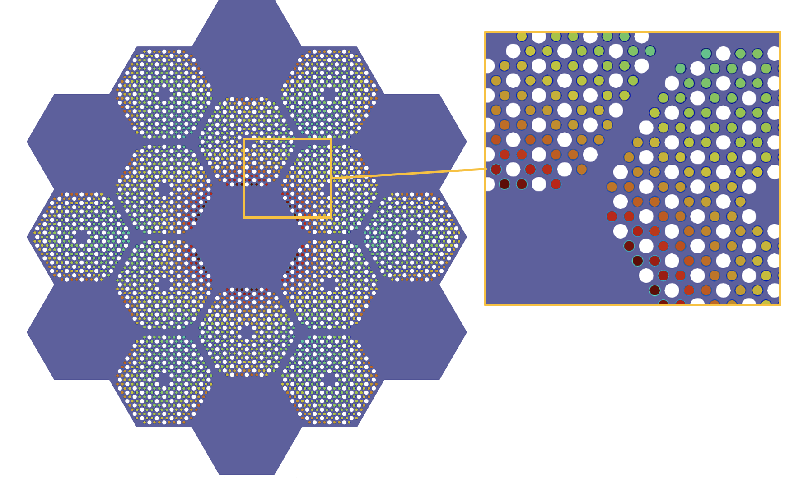
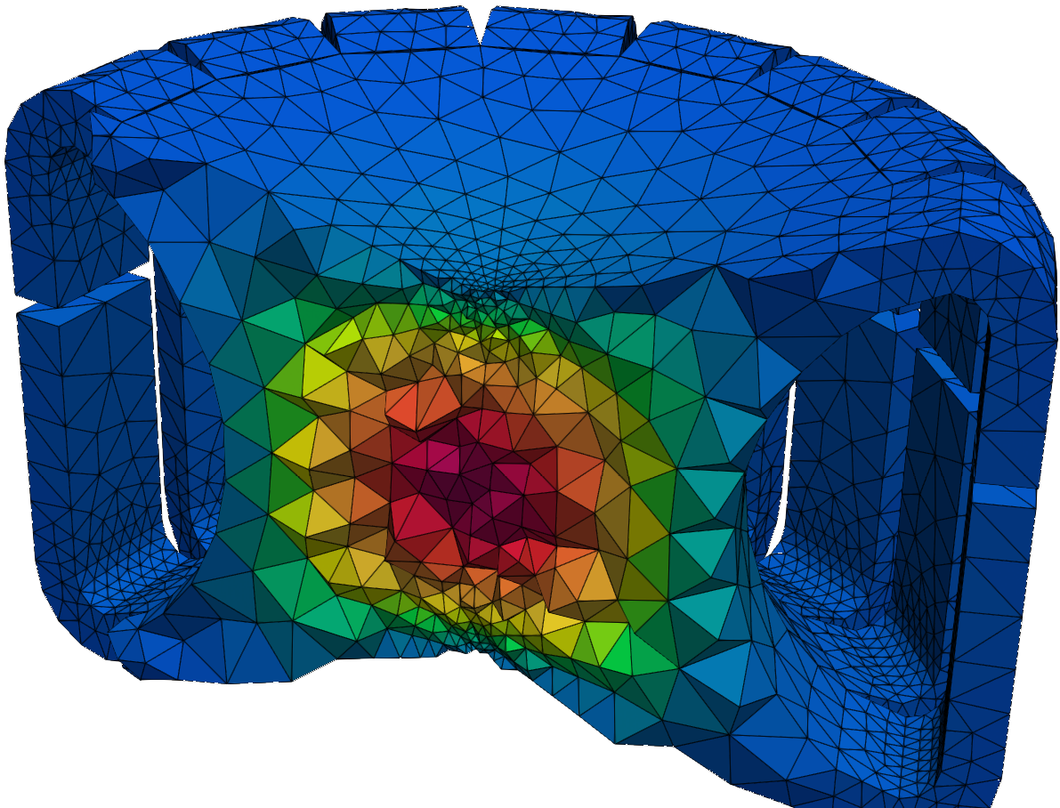
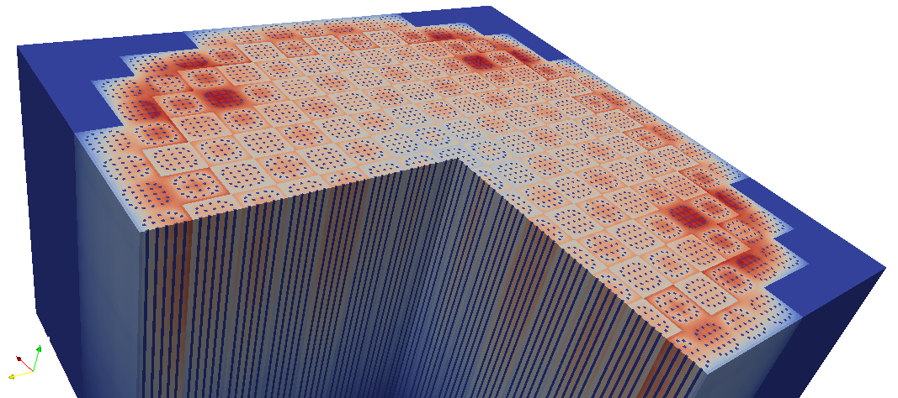
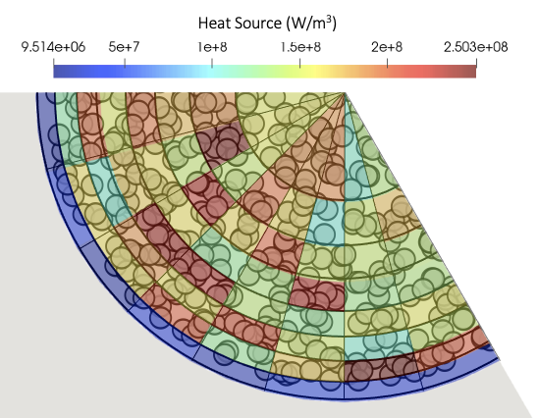
OpenMC
Modes/solvers: Fixed-source, k-eigenvalue, depletion, volume, geometry plotting
Geometry: Constructive solid geometry, CAD surface mesh, unstructured mesh
Tallies: cell tallies, structured mesh tallies, unstructured mesh tallies
Cell tally
Structured mesh tally
Unstructured mesh tally
Notes:
complementary to experimental programs

Slide 8
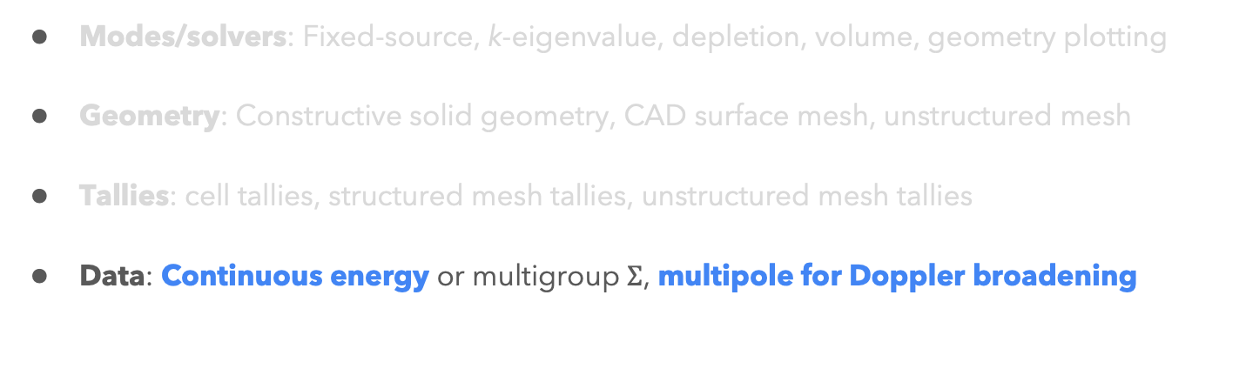
OpenMC
Modes/solvers: Fixed-source, k-eigenvalue, depletion, volume, geometry plotting
Geometry: Constructive solid geometry, CAD surface mesh, unstructured mesh
Tallies: cell tallies, structured mesh tallies, unstructured mesh tallies
Data: Continuous energy or multigroup $Σ$, multipole for Doppler broadening
Notes:
complementary to experimental programs

Slide 9
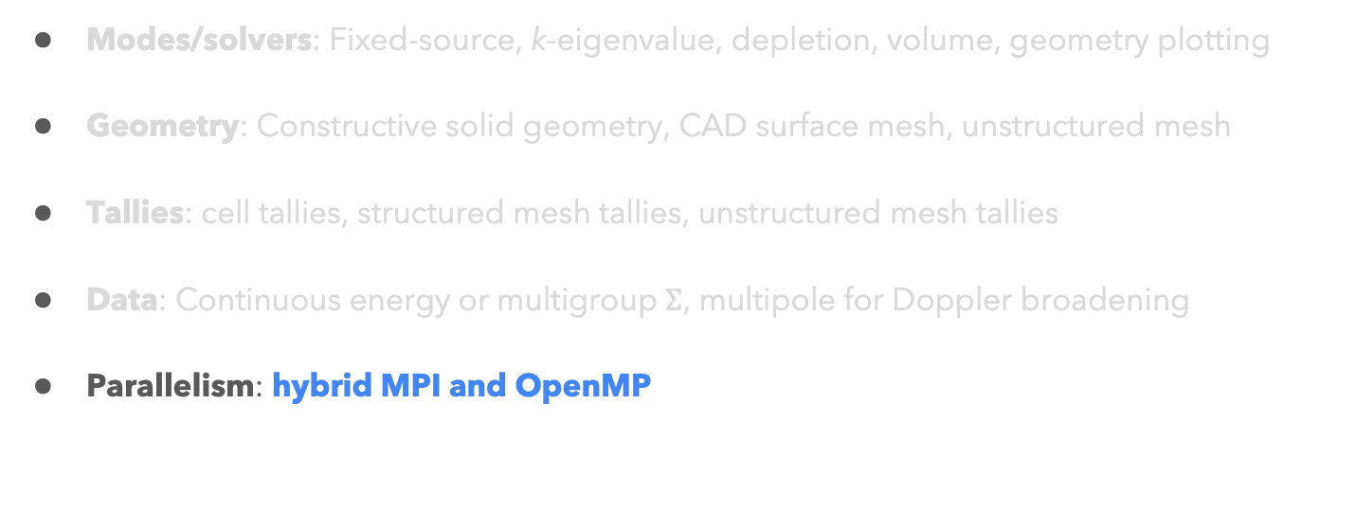
OpenMC
Modes/solvers: Fixed-source, k-eigenvalue, depletion, volume, geometry plotting
Geometry: Constructive solid geometry, CAD surface mesh, unstructured mesh
Tallies: cell tallies, structured mesh tallies, unstructured mesh tallies
Data: Continuous energy or multigroup $Σ$, multipole for Doppler broadening
Parallelism: hybrid MPI and OpenMP
Notes:
complementary to experimental programs

Slide 10
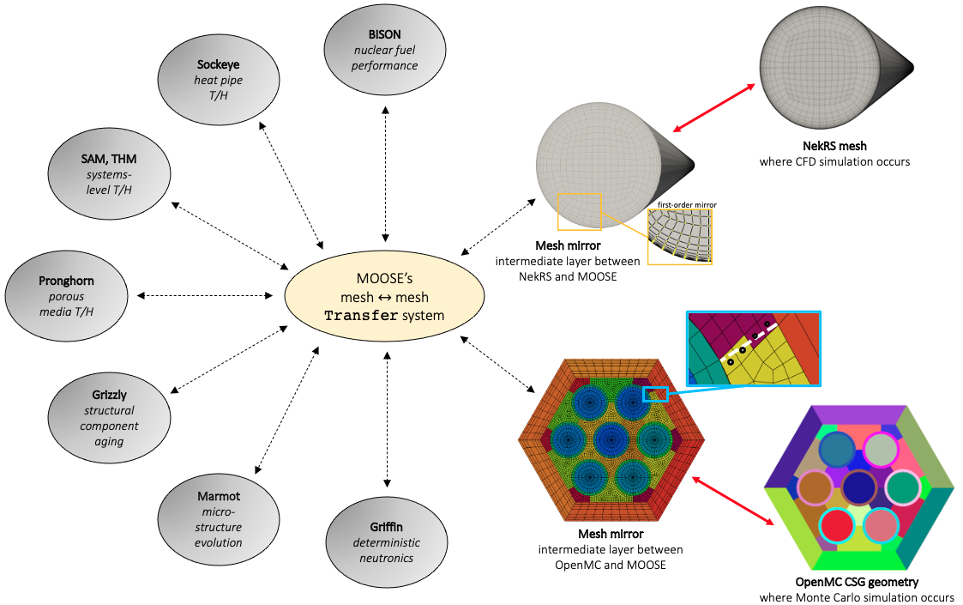
Cardinal
NekRS
wall temperature
fluid density
Write OpenMC tallies into AuxVariables
Read temperature, density, displacement from AuxVariables into OpenMC
Allows OpenMC to interact with MOOSE for physics feedback and postprocessing
fluid temperature
inlet/outlet BCs
tallies (e.g. power, fluence)
OpenMC

Slide 11
Cardinal
NekRS
wall heat flux
Write OpenMC tallies into AuxVariables
Read temperature, density, displacement from AuxVariables into OpenMC
Allows OpenMC to interact with MOOSE for physics feedback and postprocessing
power density
inlet/outlet BCs
density
temperature
geometry
composition
OpenMC

Slide 12
Docker Instructions
To test if Docker works:
cd openmc/live
cardinal-opt -i testing.i
Notes:
complementary to experimental programs

Slide 13
Compiling Cardinal (After the workshop!)
git clone https://github.com/neams-th-coe/cardinal.git
cd cardinal
./scripts/get-dependencies.sh
./contrib/moose/scripts/update_and_rebuild_petsc.sh ./contrib/moose/scripts/update_and_rebuild_libmesh.sh ./contrib/moose/scripts/update_and_rebuild_wasp.sh
make -j8
Compile all dependencies with a single make command, which gives you:
Cardinal executable (cardinal/cardinal-opt)
“standalone” OpenMC executable (cardinal/build/openmc/bin/openmc)
“standalone” NekRS executable (cardinal/install/bin/nrsmpi)
Can selectively enable parts of Cardinal using ENABLE_NEK, ENABLE_OPENMC, ENABLE_DAGMC
General workflow:
Develop ”standalone” NekRS/OpenMC input files
Develop a MOOSE-type “wrapper” input file
Ready to run!
download the Cardinal source code
download the OpenMC and NekRS
source code
build MOOSE 3rd-party dependencies
compile Cardinal

Slide 14
How to Get Involved
Git repository: https://github.com/neams-th-coe/cardinal
Discussions page: https://github.com/neams-th-coe/cardinal/discussions
Documentation: https://cardinal.cels.anl.gov/
Contact us directly!
April Novak: ajnovak2@Illinois.edu (Cardinal lead)
Paul Romano: promano@anl.gov (OpenMC lead)
Dillon Shaver: dshaver@anl.gov (Nek lead)

Slide 15
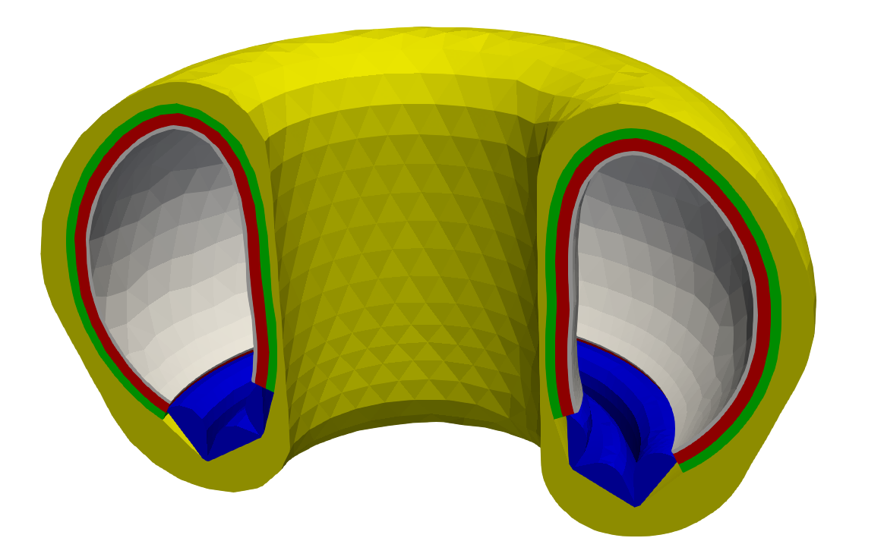
Example: Tokamak
Link: https://cardinal.cels.anl.gov/tutorials/tokamak.html
Objectives:
How to generate a CAD Monte Carlo geometry
How to set up Cardinal input files for coupling OpenMC with heat conduction
How to visualize Cardinal output files
Input files:
Meshes
MOOSE heat conduction solve: solid.i
“Standalone” OpenMC solve: model.py
Cardinal wrapping solve: openmc.i

Slide 16
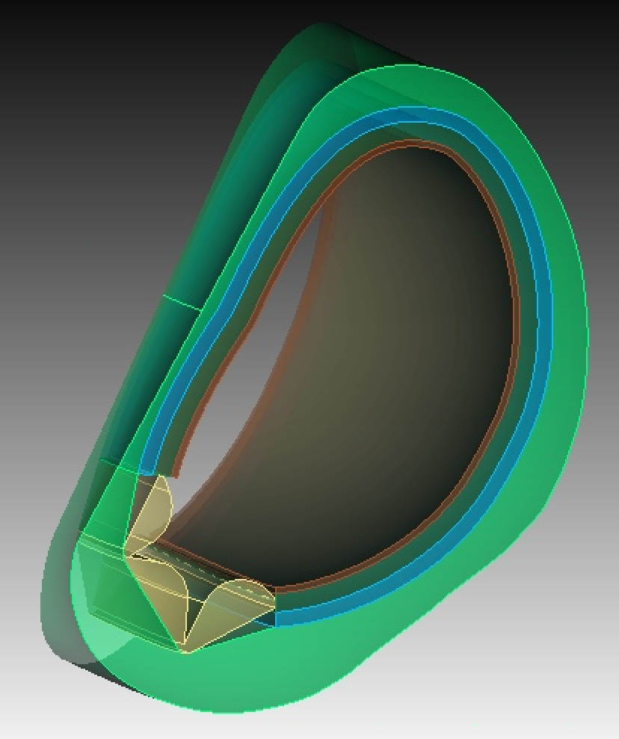
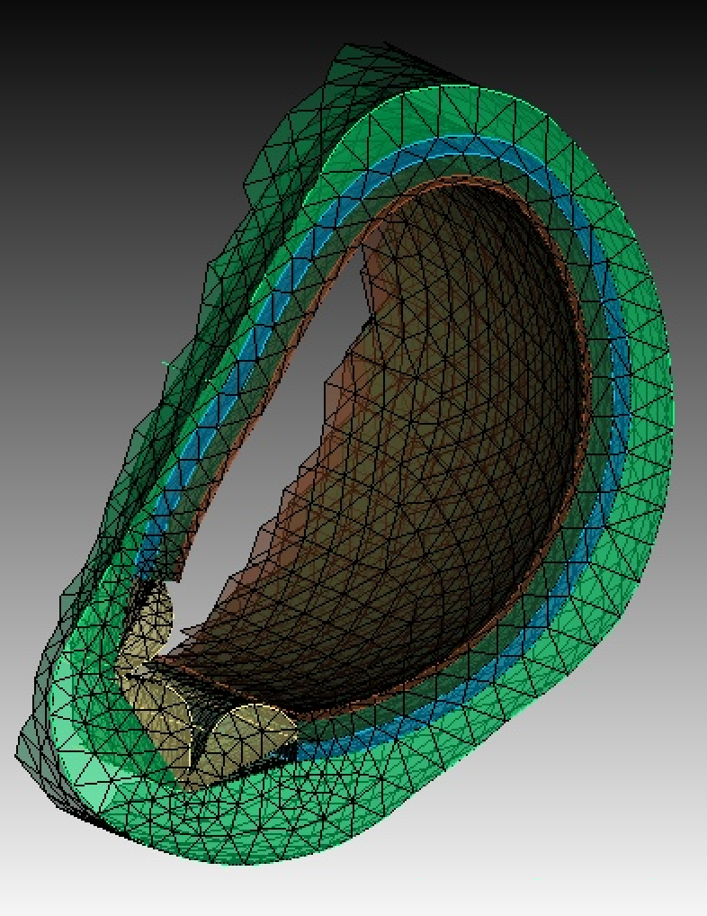
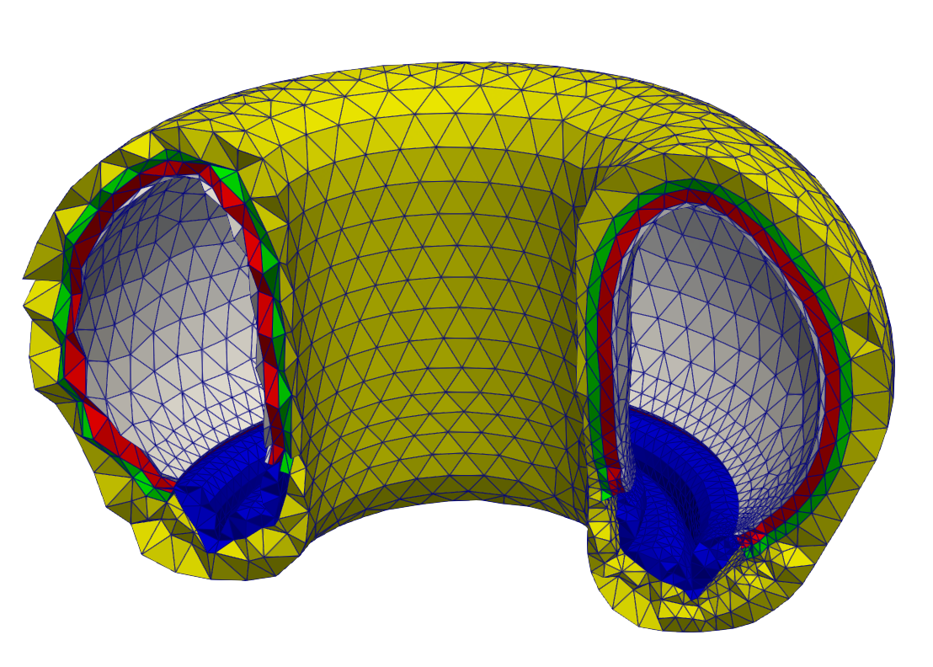
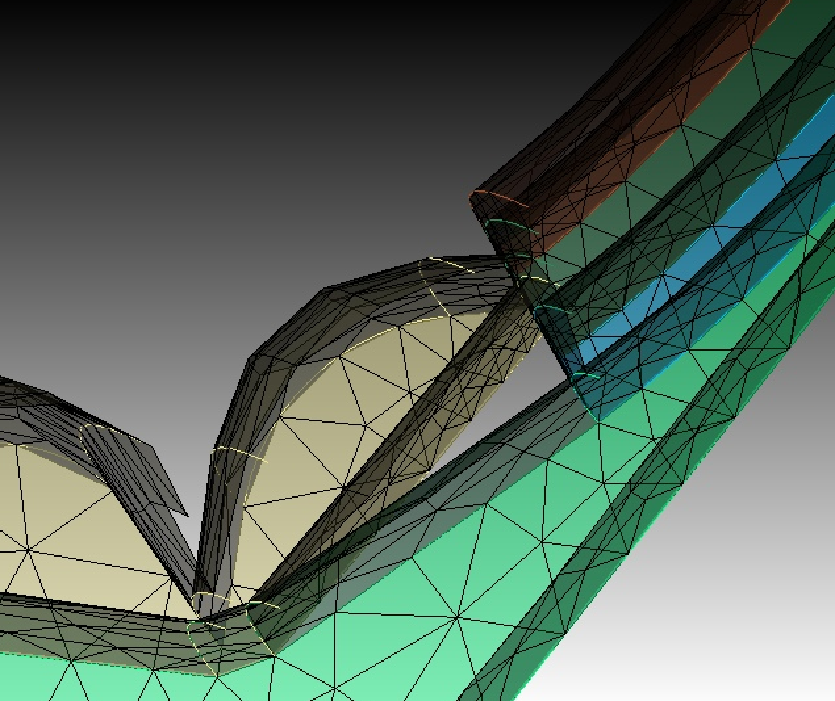
Geometry
Volume unstructured mesh: heat conduction, tallying in OpenMC, and reading/writing multiphysics data in/out of OpenMC
Surface unstructured mesh: to enclose cells for Monte Carlo transport
Facet the surfaces.
Section of a tokamak built using CAD.
Mesh the volume to give the
VOLUME MESH
Export just the surfaces to get the
SURFACE MESH

Slide 17
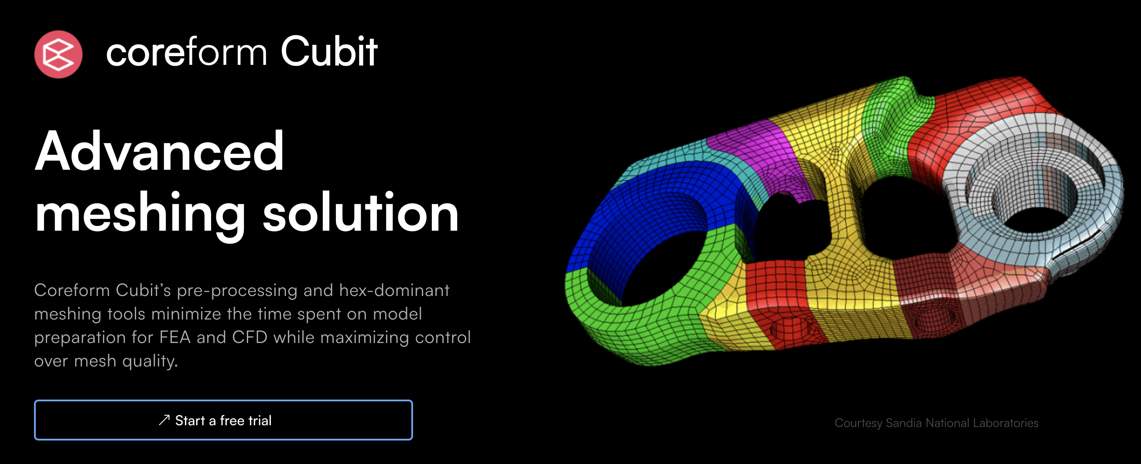
Geometry: tokamak.jou

Slide 18
Geometry: tokamak.jou
import STEP file → prepare geometry → mesh → export

Slide 19
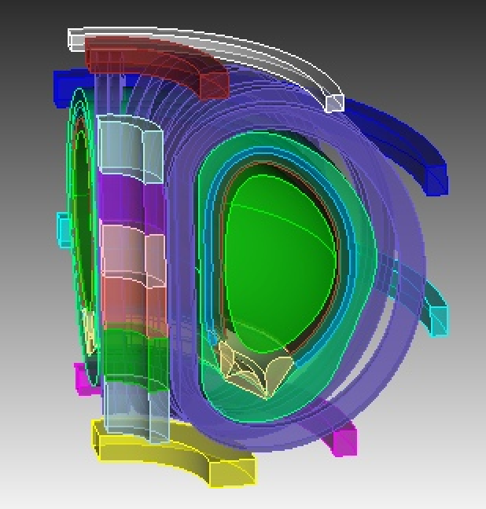
Geometry: tokamak.jou
import STEP file → prepare geometry → mesh → export

Slide 20
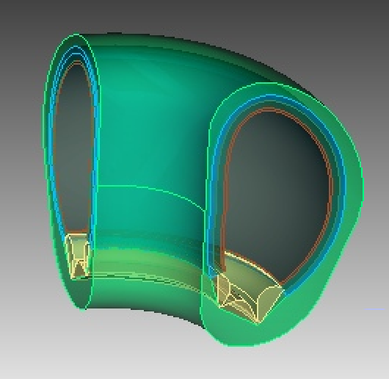
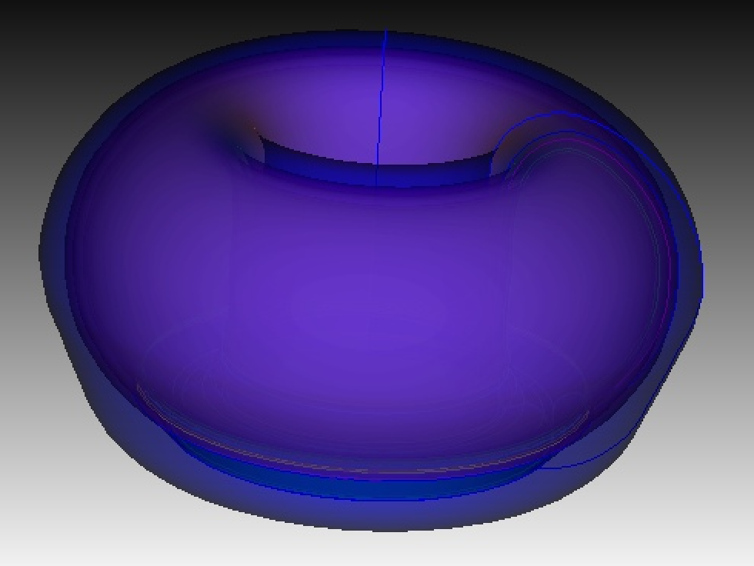
Geometry: tokamak.jou
import STEP file → prepare geometry → mesh → export
sweep into 3D

Slide 21
Geometry: tokamak.jou
import STEP file → prepare geometry → mesh → export
Create material tags and assign to blocks (this is how we tell OpenMC where to place material compositions):
create material 'ss316' property_group 'CUBIT-ABAQUS’
block 5 material 'ss316'

Slide 22
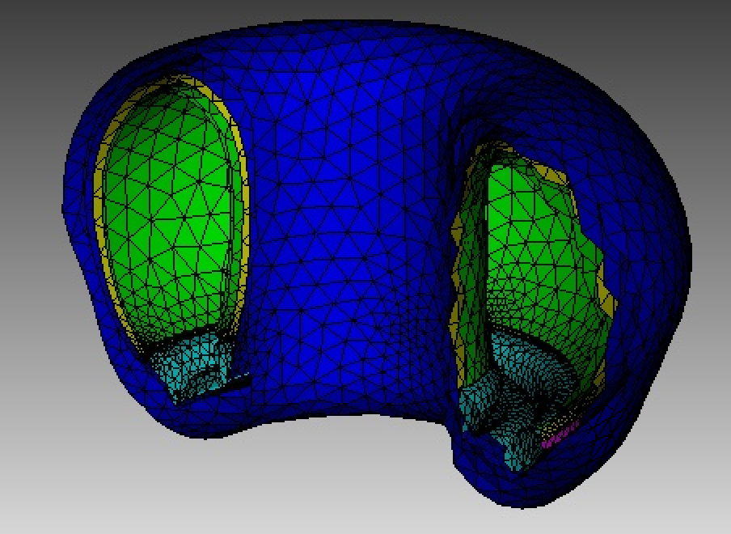
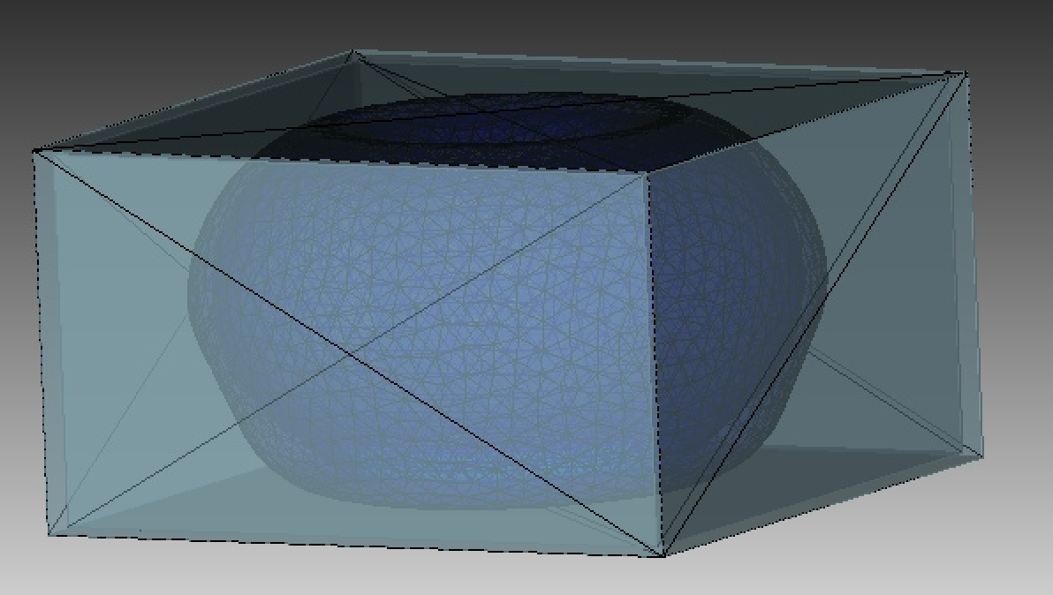
Geometry: tokamak.jou
import STEP file → prepare geometry → mesh → export
Volume mesh
Add a graveyard, then export surface mesh

Slide 23
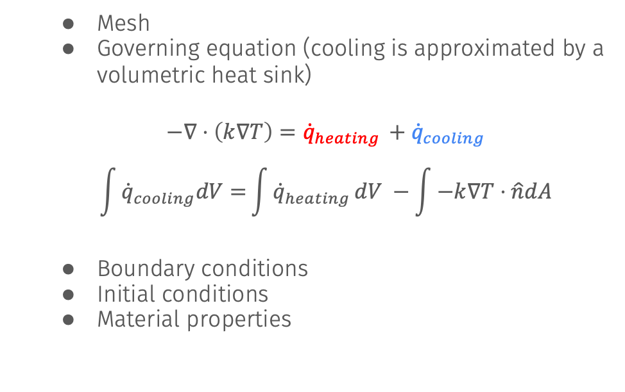
MOOSE Heat Conduction Model: solid_standalone.i
Mesh
Governing equation (cooling is approximated by a volumetric heat sink)
$$−∇⋅\left(k∇T\right)={\dot{q}}_{heating }+{\dot{q}}_{cooling}$$
$$\int{{\dot{q}}_{cooling}dV=}\int{{\dot{q}}_{heating }dV −\int{−k∇T⋅\hat{n}dA}}$$
Boundary conditions
Initial conditions
Material properties

Slide 24
OpenMC Standalone Model: model.py, openmc_standalone.i
Create XML files from model.py
Can run this just like you run a normal OpenMC model
Create a thin “wrapping” file with openmc_standalone.i
Maps data in/out of OpenMC into MOOSE AuxVariables

Slide 25
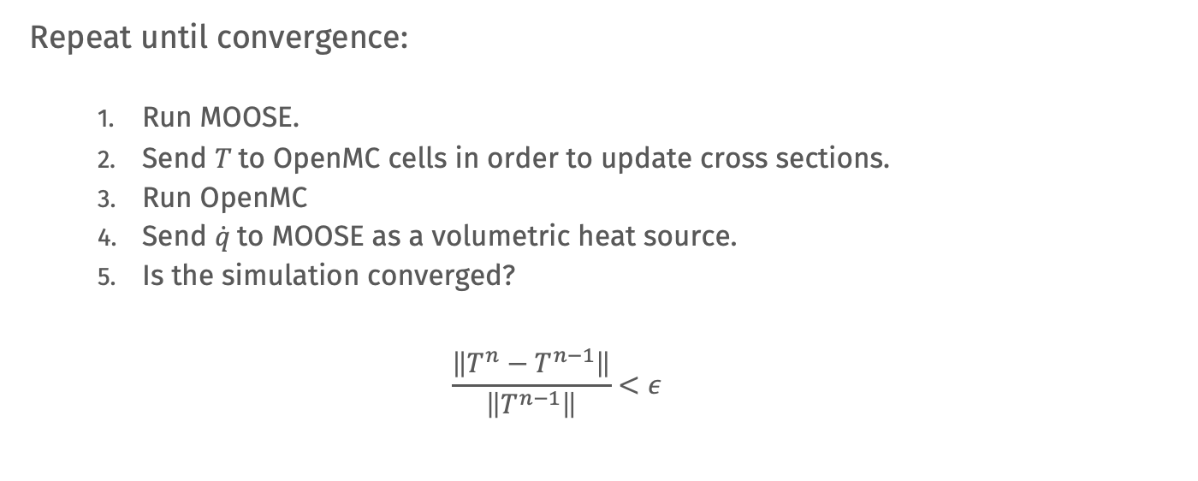
Multiphysics Coupling
Repeat until convergence:
Run MOOSE.
Send $T$to OpenMC cells in order to update cross sections.
Run OpenMC
Send $\dot{q}$to MOOSE as a volumetric heat source.
Is the simulation converged?
$$\frac{\left\|T^{n}−T^{n−1}\right\|}{\left\|T^{n−1}\right\|}<ε$$

Slide 26
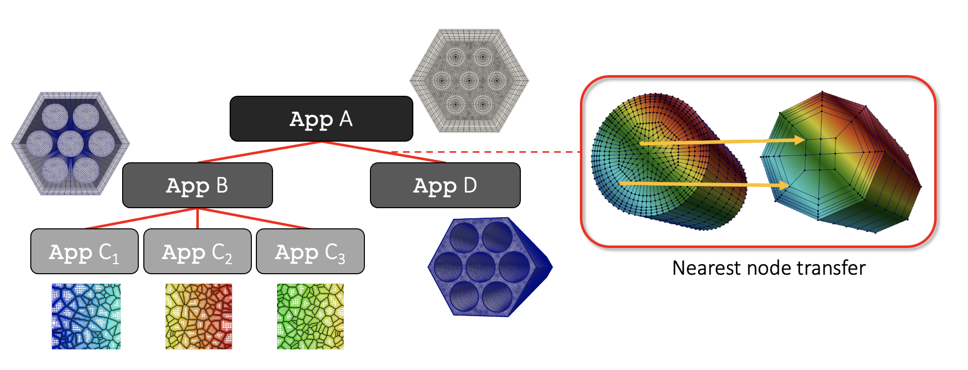
MultiApps and Transfers

Slide 27
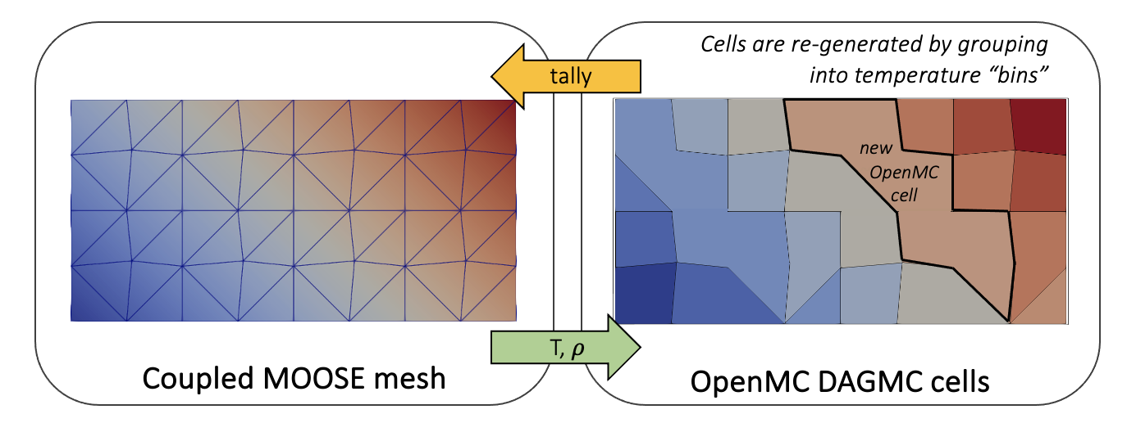
Geometry Skinning
OpenMC can only use a single temperature/density for every cell (5 temperatures in this case!)
On-the-fly geometry refinement to resolve temperature, density fields (developed by Dr. Helen Brooks, UKAEA)

Slide 28
Coupled Model: openmc.i, solid.i

Slide 29
Cardinal couples OpenMC to MOOSE for multiphysics feedback and data postprocessing
Additional tutorials which couple OpenMC to MOOSE: https://cardinal.cels.anl.gov/tutorials/index.html
Notes:
complementary to experimental programs

